Slide 1
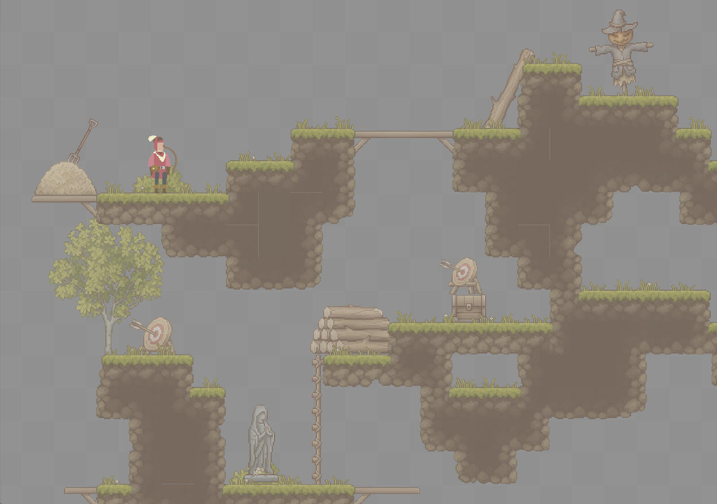

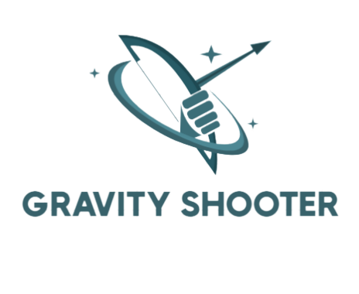
Gravity shooter game using ML – Player behavior analysis
Software Engineering Department Braude College of Engineering
Capstone Project Phase B – 61999
GitHub Repository
23-2-D-22
Advisor: PhD. Sulamy Moshe
MosheSu@braude.ac.il
Students:
Yosif Housen - Yosif.Hosen@e.braude.ac.il
Ibrahim Daoud - Ibrahim.Daoud@e.braude.ac.il

Slide 2

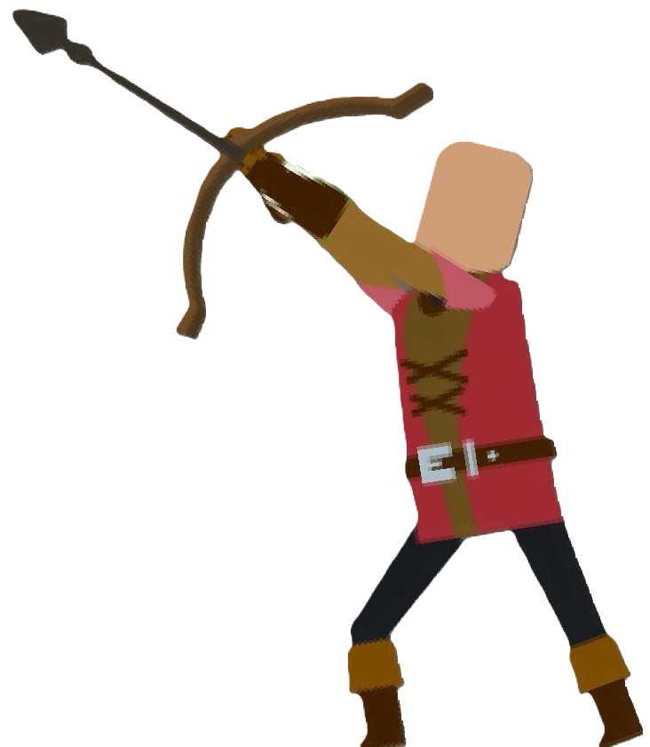
Let's Shoot
Gravity Shooter
Game Environment
3 modes:
Training
Solo
Multiplayer

Slide 3

Problem
Current Educational Tools
Barriers to Learning
One-Size-Fits-All approach
Notes:
Traditional educational methods and lab simulations can be unengaging and complex.
Lack of interactive and enjoyable learning tools that capture and retain the interest of children.

Slide 4
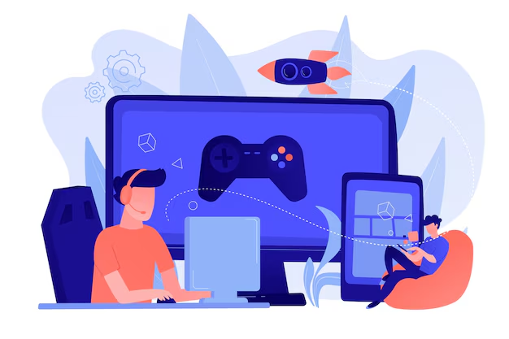
Solution
Innovative Gameplay
Training Environment
Machine Learning Integration
Gravity & Force manipulation

Slide 5
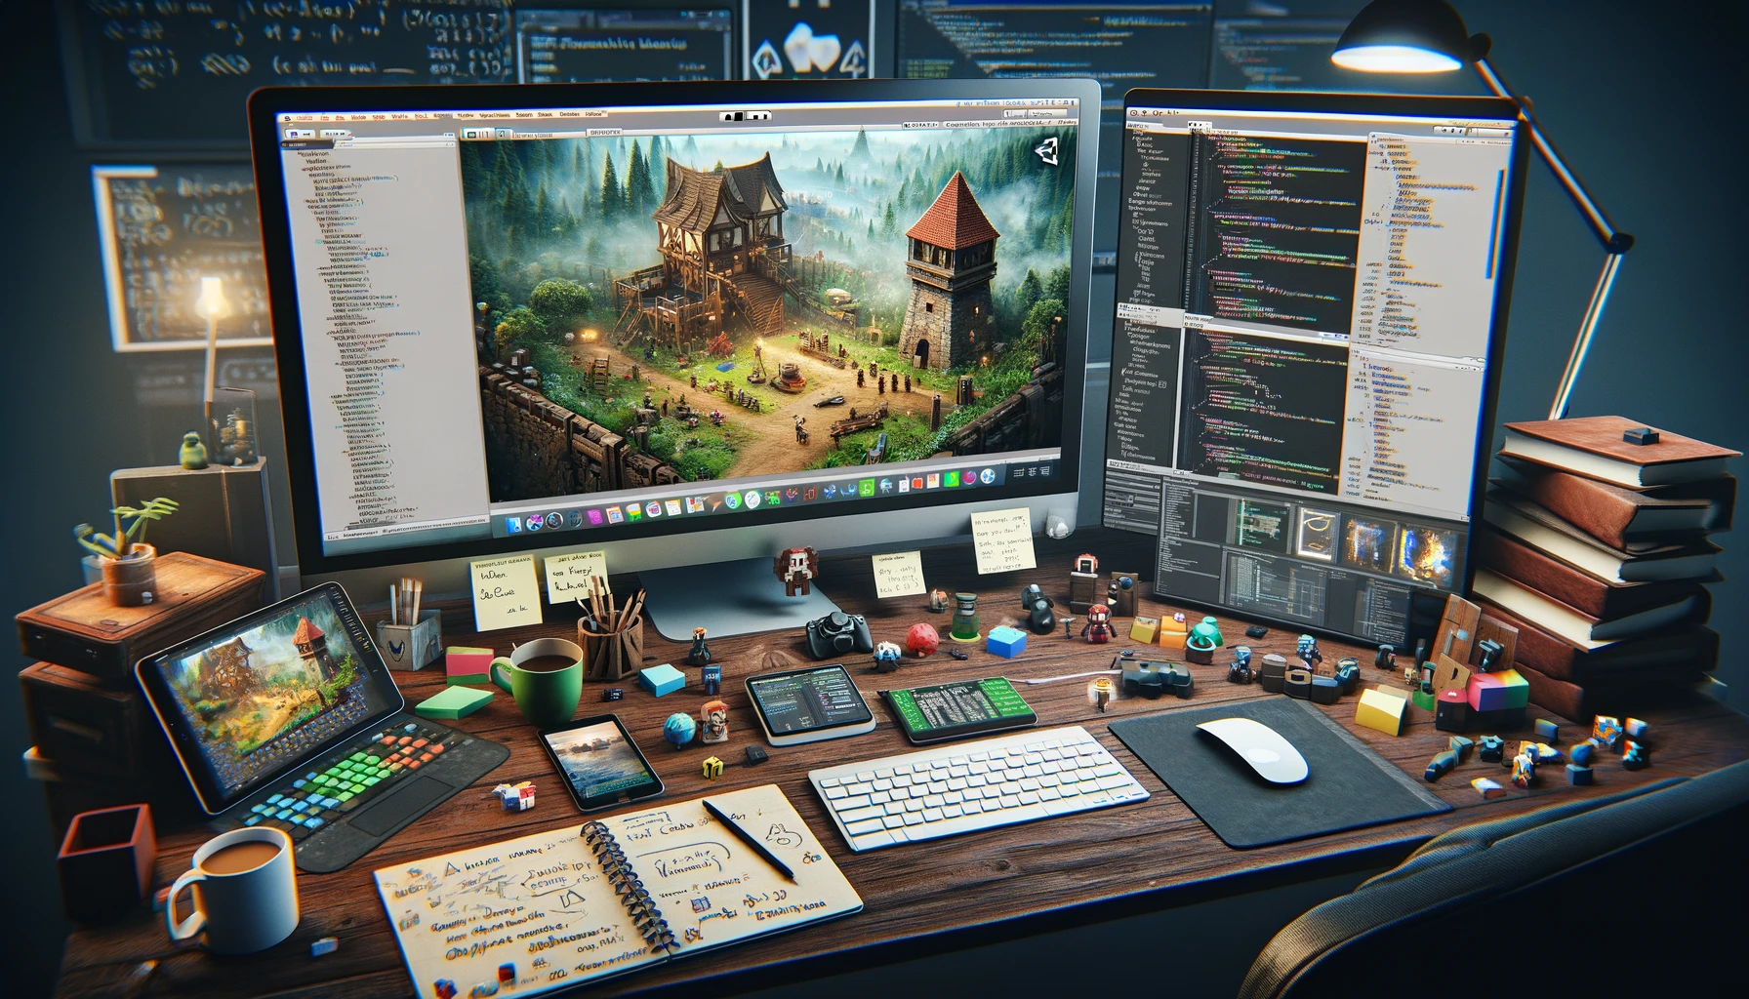
Developing the solution

Slide 6
Server
User Credentials
Deployment on AWS:
Industry – based
Free – tier
Region: eu-north-1 , Stockholm
Notes:
User Credentials

Slide 7
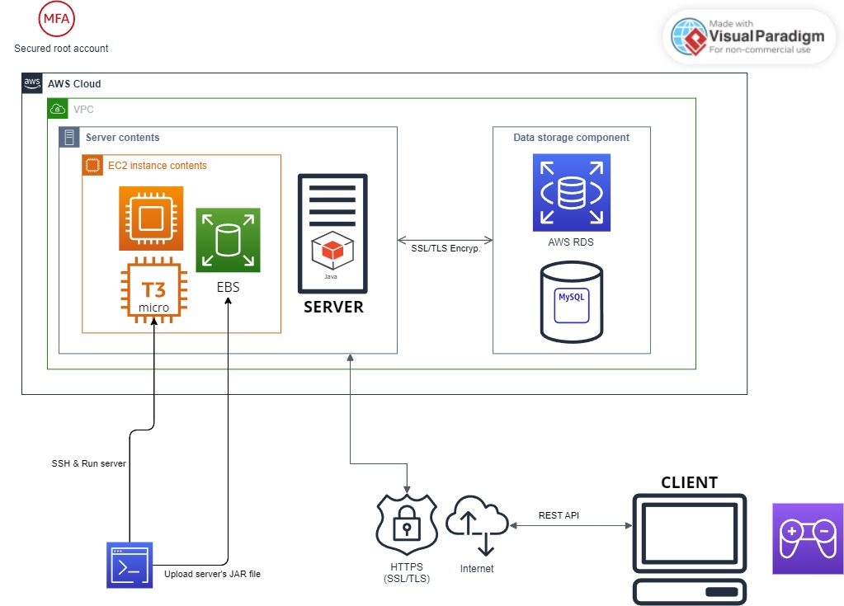
AWS Architecture Diagram

Slide 8
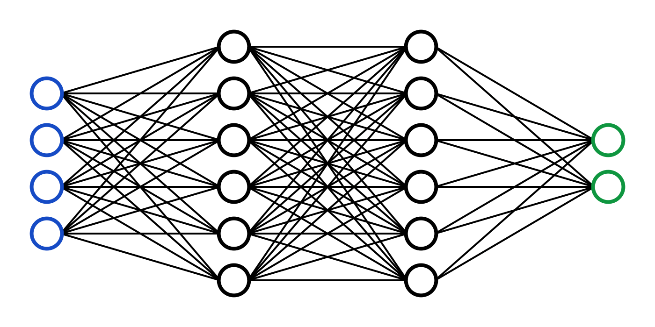
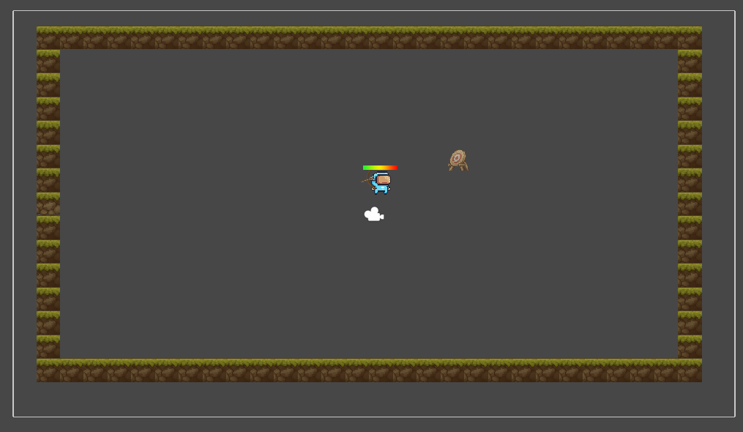


Reinforcement Learning
Mlagents
Notes:
Training: During training, the agent performs actions within the Unity environment and receives feedback in the form of rewards. Based on this feedback, the model updates itself to maximize its performance over time, using reinforcement learning or other machine learning methods.

Slide 9
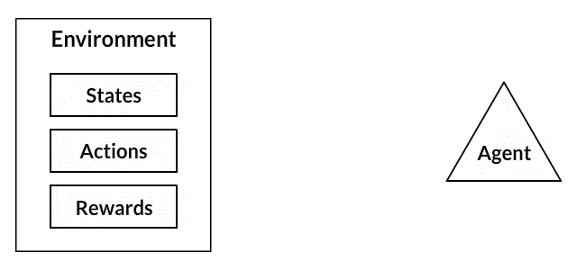
Training
Reward: +1
Penalty: -1
192 Environments
Notes:
The player is the agent that exists in the unity environment
The environment has a “state” that changes over time. In our case, the target position

Slide 10
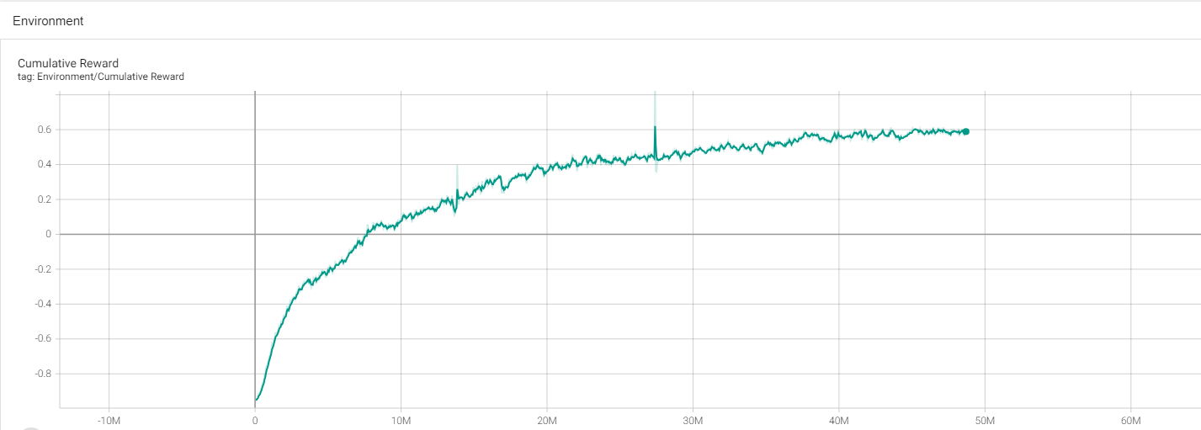
Cumulative Reward Graph
Cumulative Reward: ~0.6
Training time: 67 Hours (~2.8 days)
49M steps

Slide 11
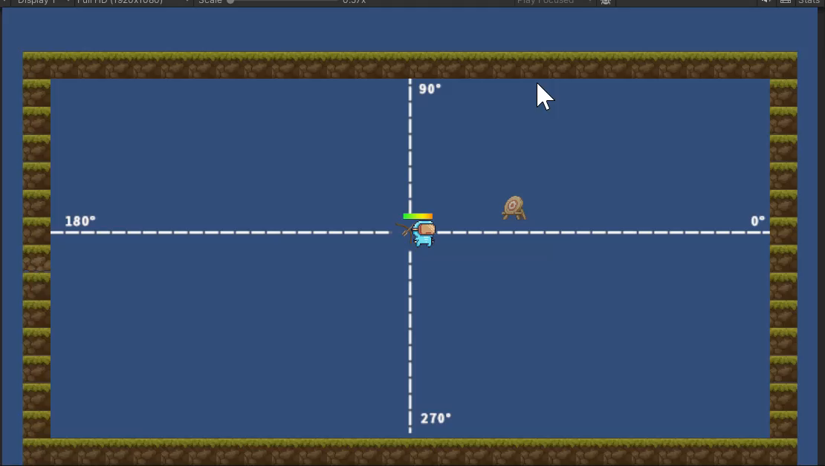
Training Scene
Tips\Suggestions , increase\decrease angle\force

Slide 12
Almost there

Slide 13
Multiplayer Infrastructure
Relay Netcode
Lobby
Unity Cloud
Notes:
Seamless Synchronization and Reduced Latency
Ensures consistent game state across all players by centralizing data processing.
Improves overall gameplay smoothness and responsiveness, critical for real-time strategy and precision in physics-based environments.
Enhanced Security and Fair Play
Central servers facilitate better monitoring and control, reducing the risk of cheating and hacks.
Provides a secure, managed platform that maintains integrity and fairness in competitive multiplayer scenarios.
Dynamic Scalability and Reliability
Cloud infrastructure adapts to player demand, ensuring stable performance during peak times and varying load conditions.
Guarantees high availability and minimal downtime, providing a reliable gaming experience for all users globally.

Slide 14

Screens & Flow

Slide 15
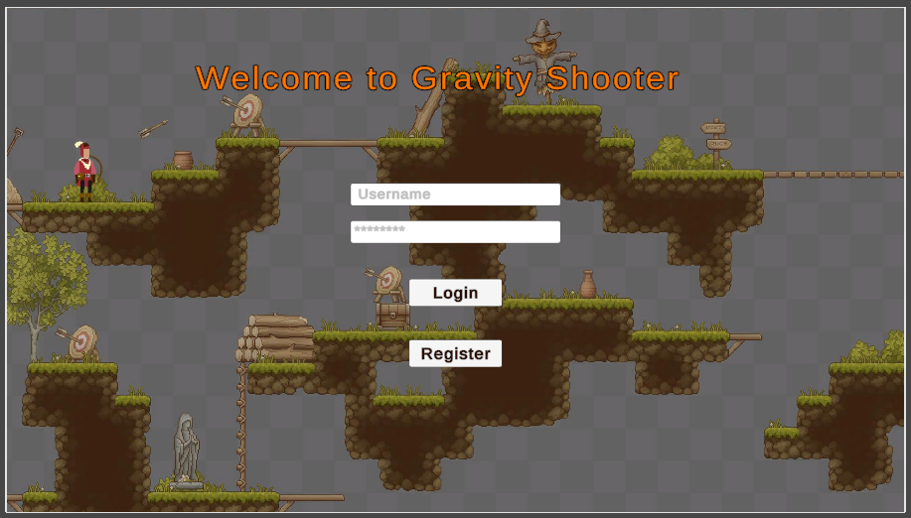
Login

Slide 16
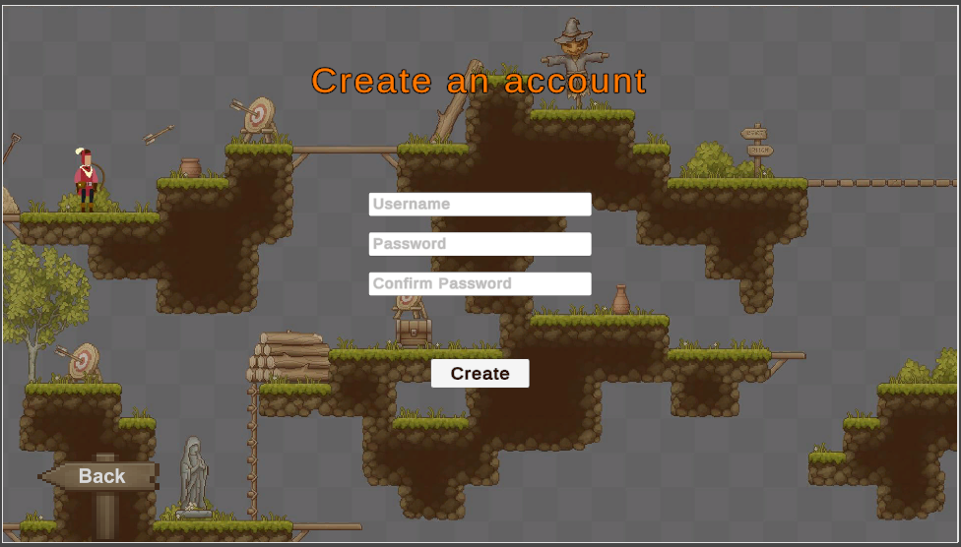
Registration

Slide 17
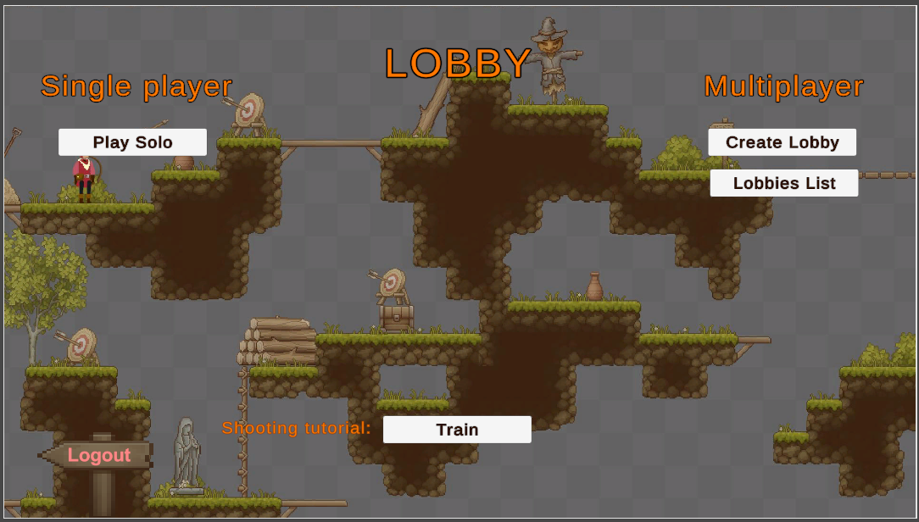
Lobby

Slide 18
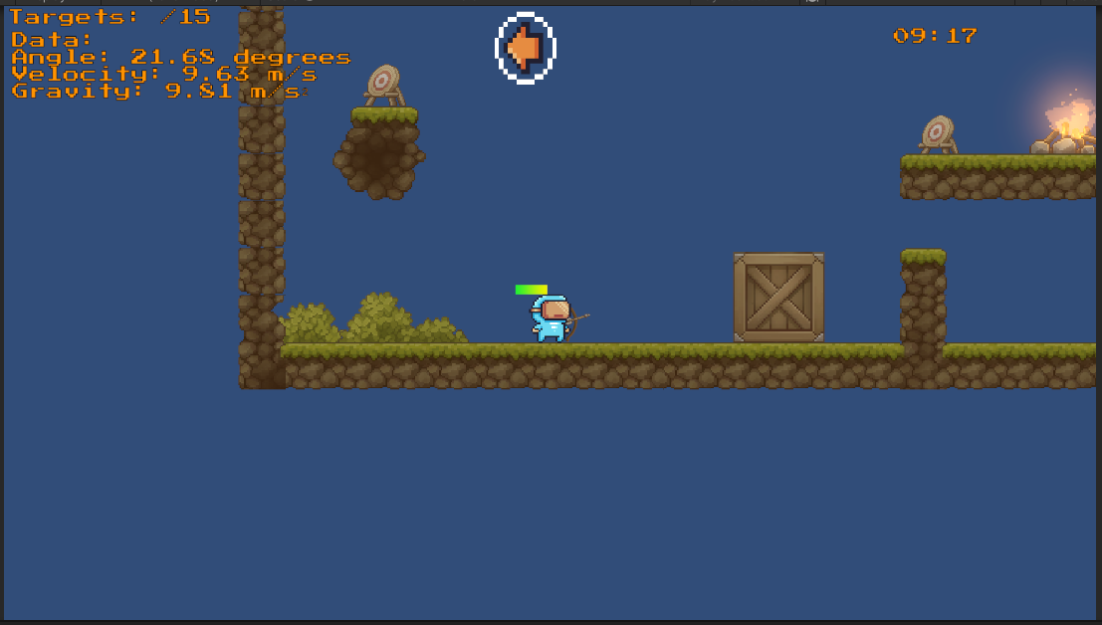
Solo Mode

Slide 19
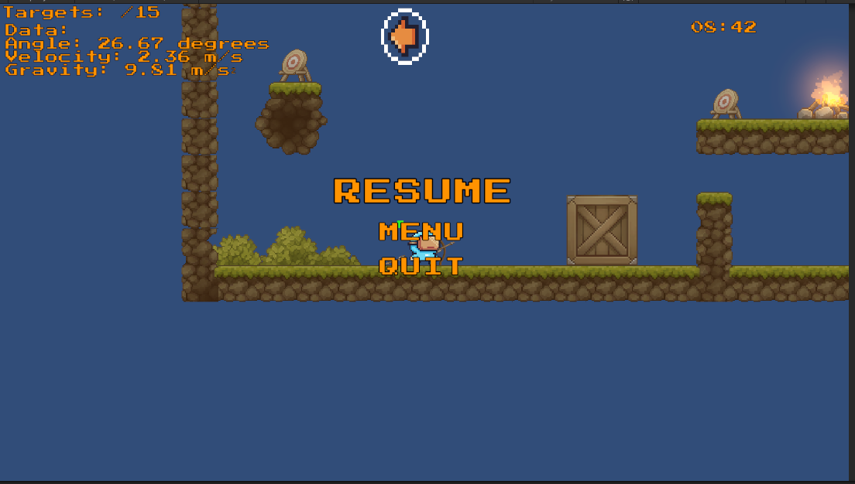
Pause menu

Slide 20
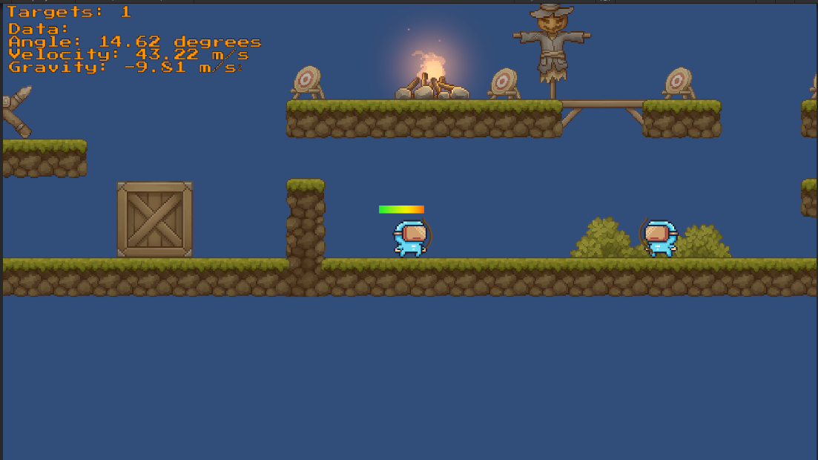
Multiplayer

Slide 21
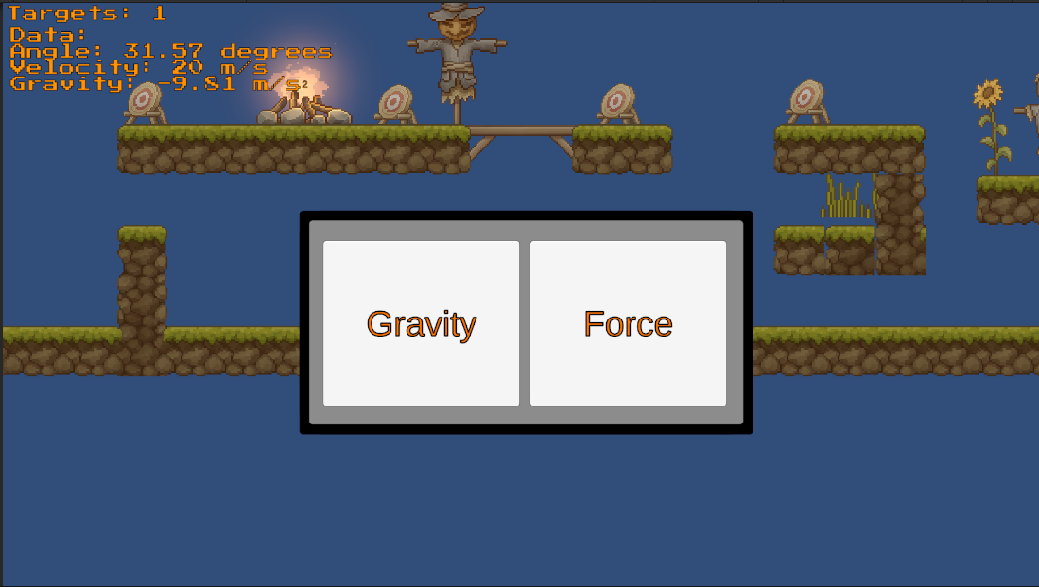
Special power

Slide 22
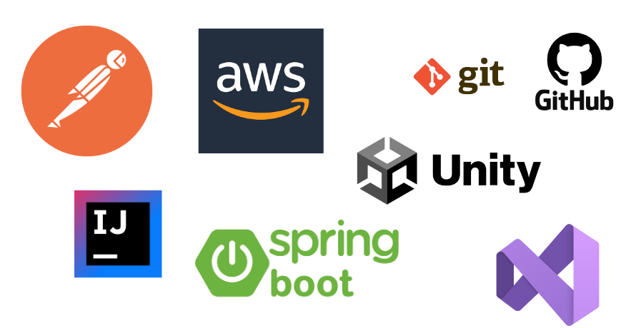
Tools we used
Notes:
We used postman to check our server’s endpoints git+github for version control IDE’s …

Slide 23
Further Improvements
Adding levels
Integrating the ML model during gameplay (requires huge amount of training)
3D
Adding music & Sound effects

Slide 24

Live DEMO

Slide 25
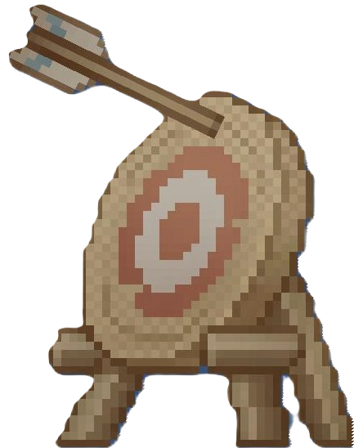
Thank You ;)
Oops!! Our AI will help with that

